Slide 1
2014 Leadership Meeting
GE MR PM Procedure

Slide 2
Basic GE MR PM Procedure 9.x – 12.x
Objective
Build upon your current basic knowledge and perform a standard PM on a GE MRI system
Materials Needed
“GE MR PM Protocols 9to12” Word Document
GE Documentation for your system
Basic system and scanning knowledge
Vacuum
Flat blade screwdriver
Philips screwdriver
PM checklist

Slide 3
First Things First
Preliminary system checks and backups
Before you get started tearing into the system it’s a good idea to see where your at and get the software backed up.
Create a Save Info (next slide)
Check the error log for any glaring issues
Ask the Technologist(s) if they have had any reoccurring issues

Slide 4
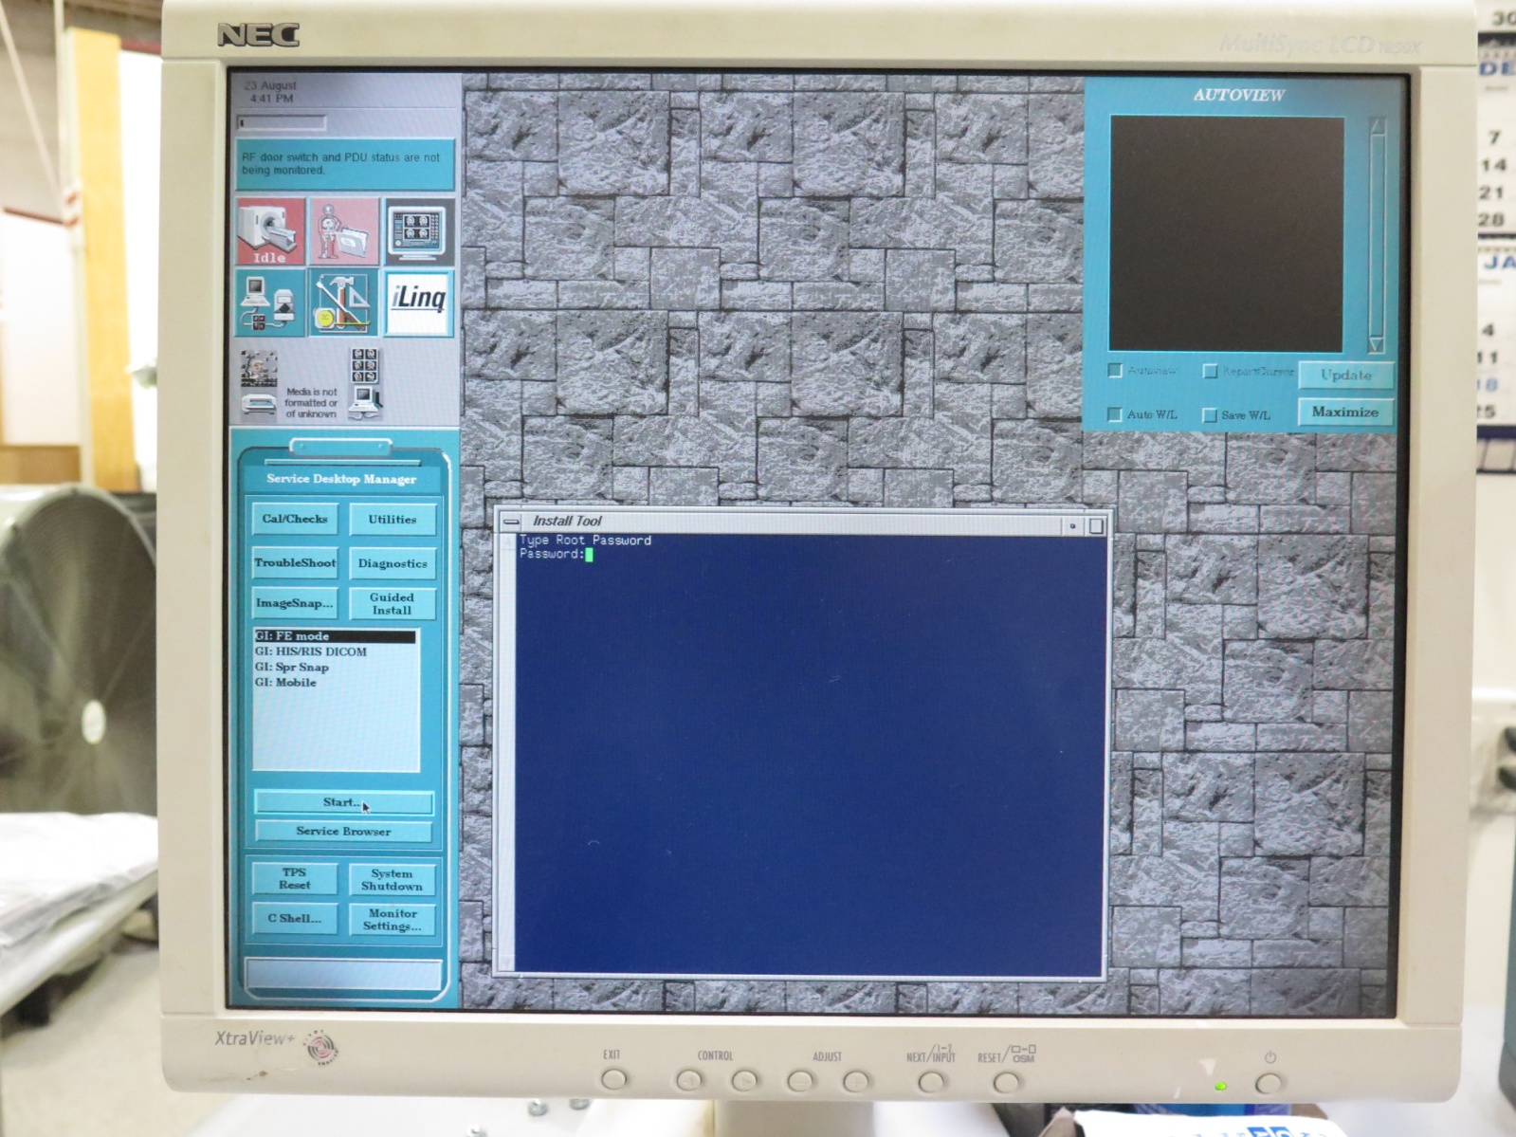
Save Info/GI
To do a Save Info:
Select the Tools page
Select “Guided Install”
Select “FE mode”
Type in the password
and hit enter

Slide 5
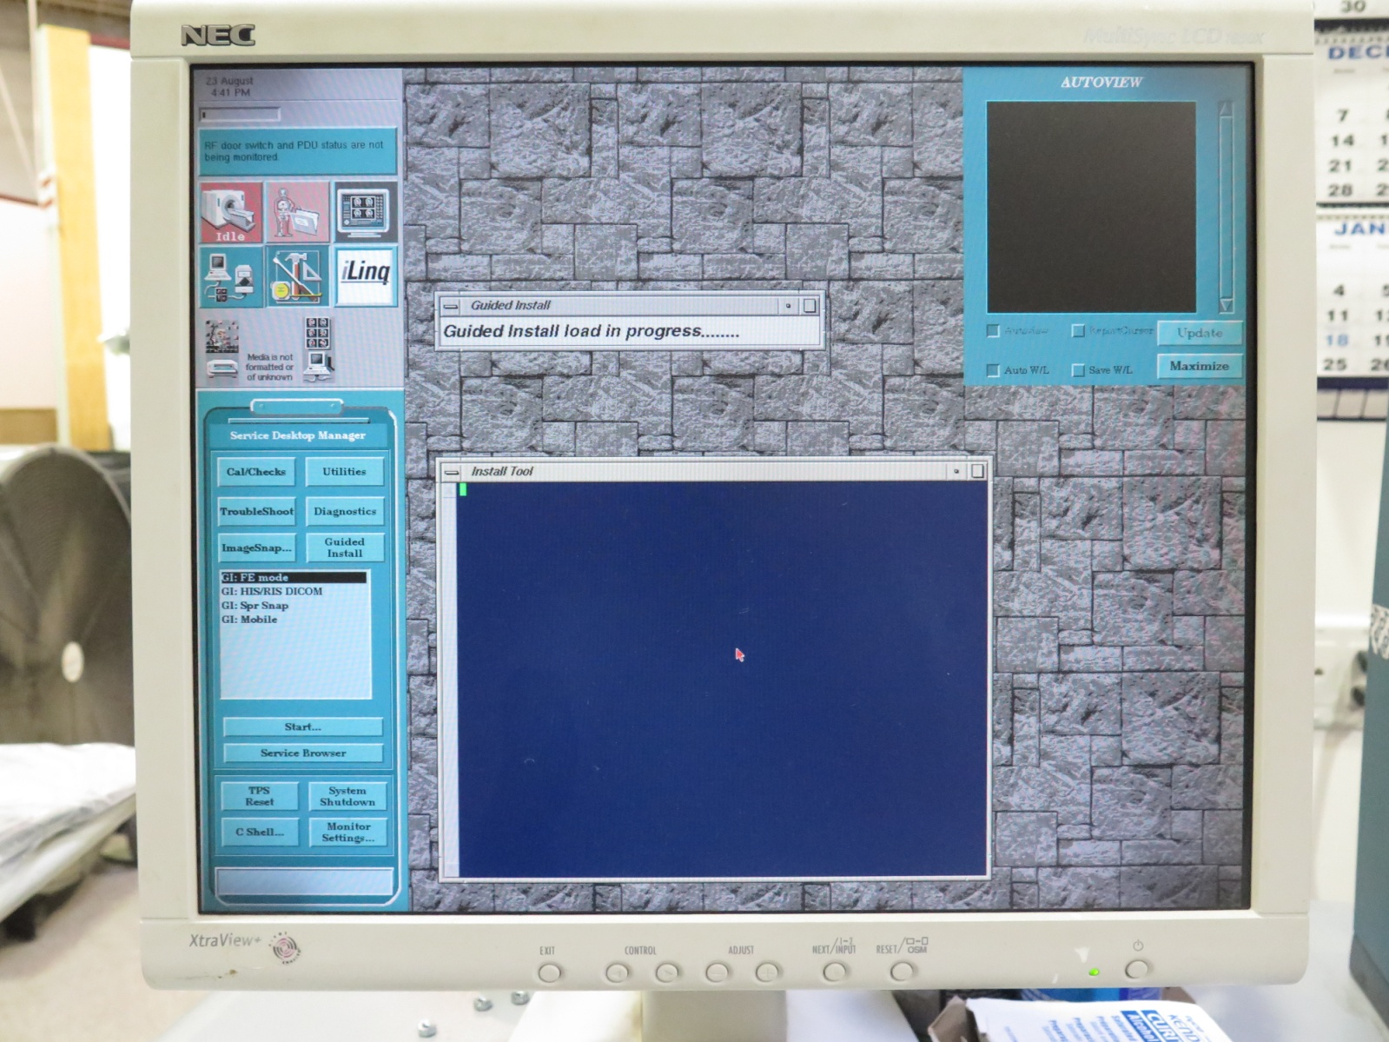
Save Info Page 2
Wait…….

Slide 6
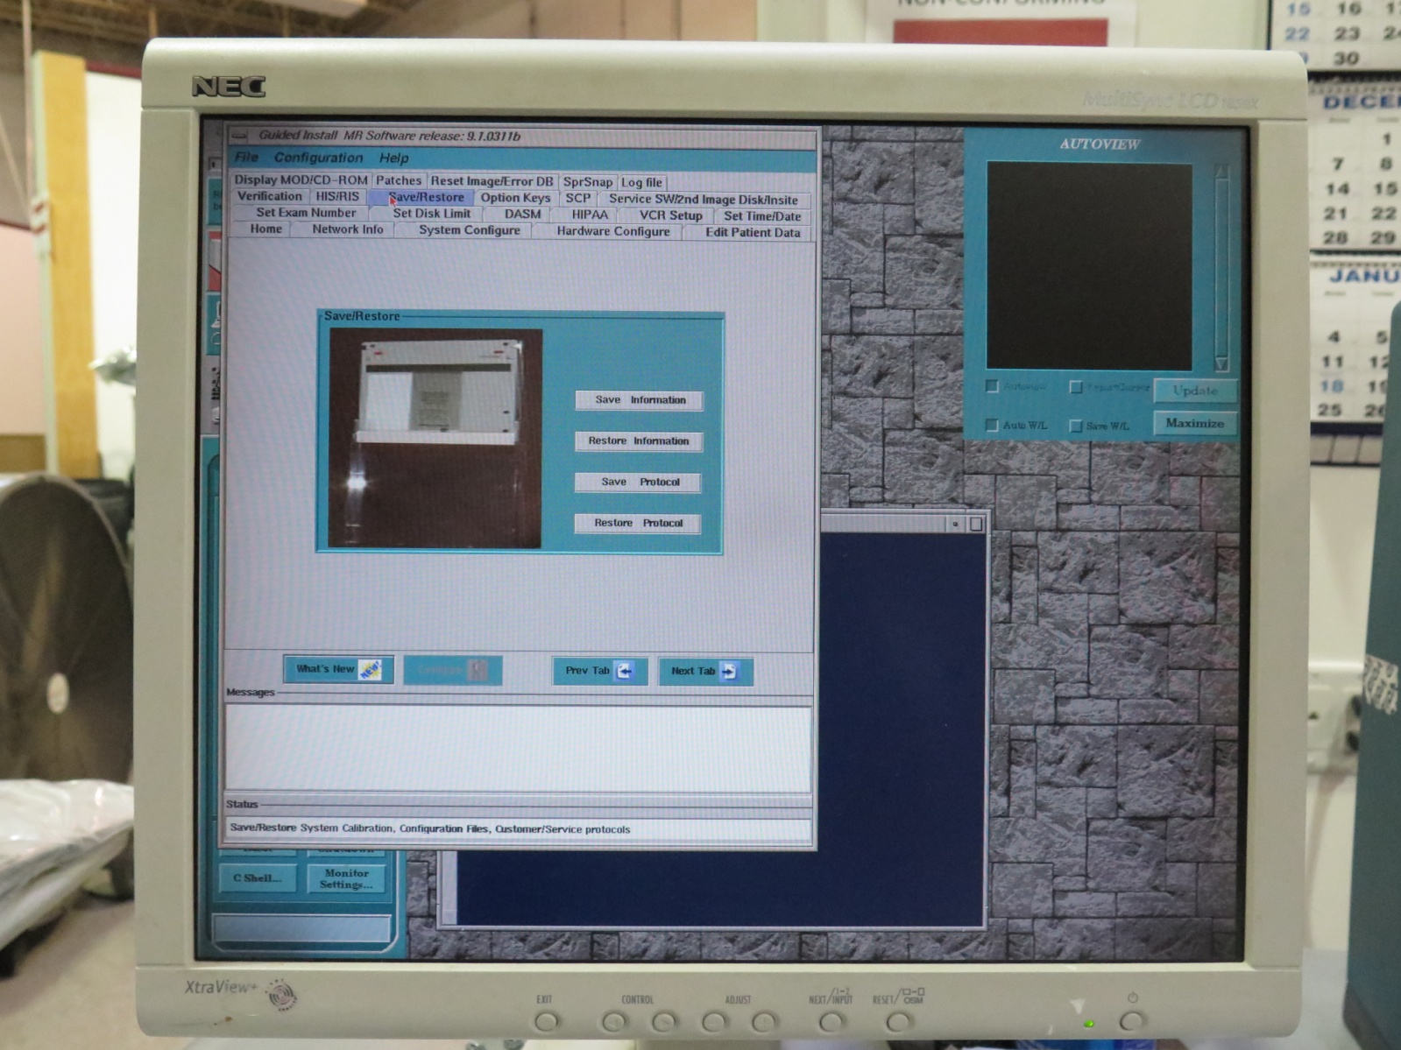
Save Info Page 3
Select the
“Save/Restore” tab
Select “Save
Information”
Wait a few minutes
for it to complete

Slide 7
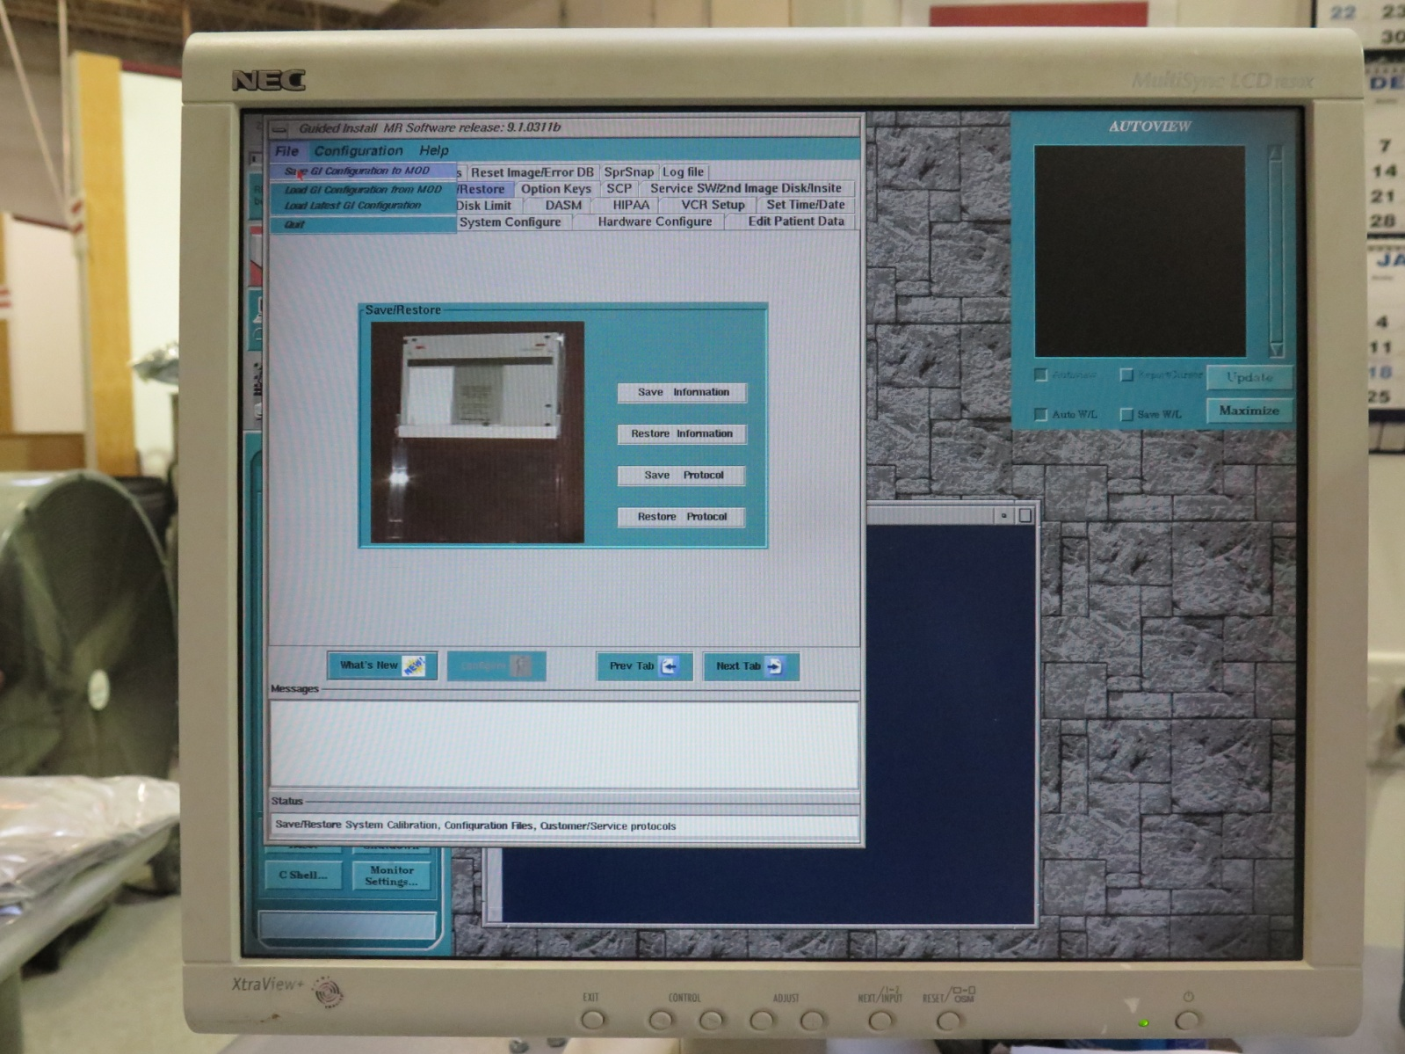
Save Info Page 4
After the save is
complete, select file
in the upper left
corner and select
“Save GI
Configuration to
MOD”

Slide 8
System Scanning
What scans are we going to do?
LV Shim
DQA Z Iso
Grad Cals
Head and Body SNR

Slide 9
Exam Setup
You will first need to set up a new patient to begin your PM scanning.
Type “geservice” in the Patient ID box and hit enter ← very important
Type something like “AHAUGPM2016” in the Patient Name box
Type 300 in the weight box

Slide 10
LV Shim Protocol
LV Shim
Series Description – LV Shim
Patient Position - Supine
Patient Entry - Head First
Coil - Body
Plane - Axial
Mode - 2D
Pulse Seq - Spin Echo
Psd Name – LVshim (must be named this)
User CV’s – 200Hz

Slide 11
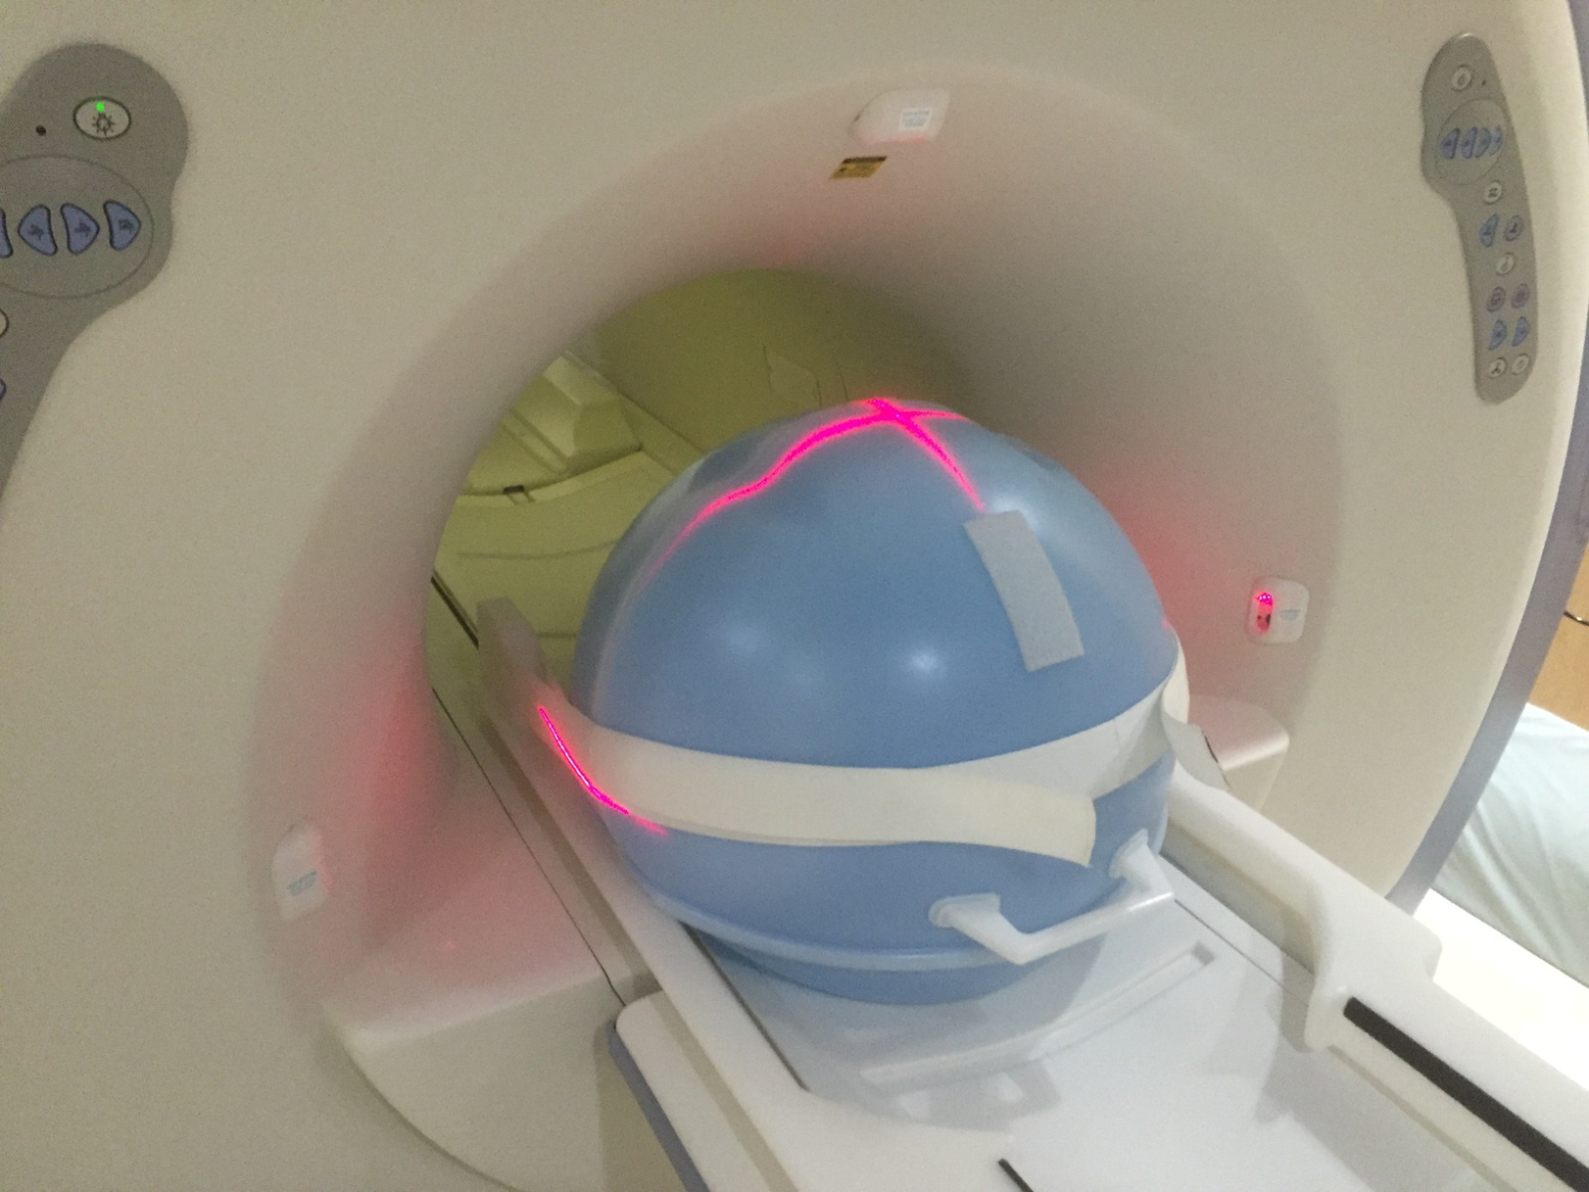
LV Shim Phantom Setup
Advance to scan
Save Series
Scan
Record the TG value

Slide 12
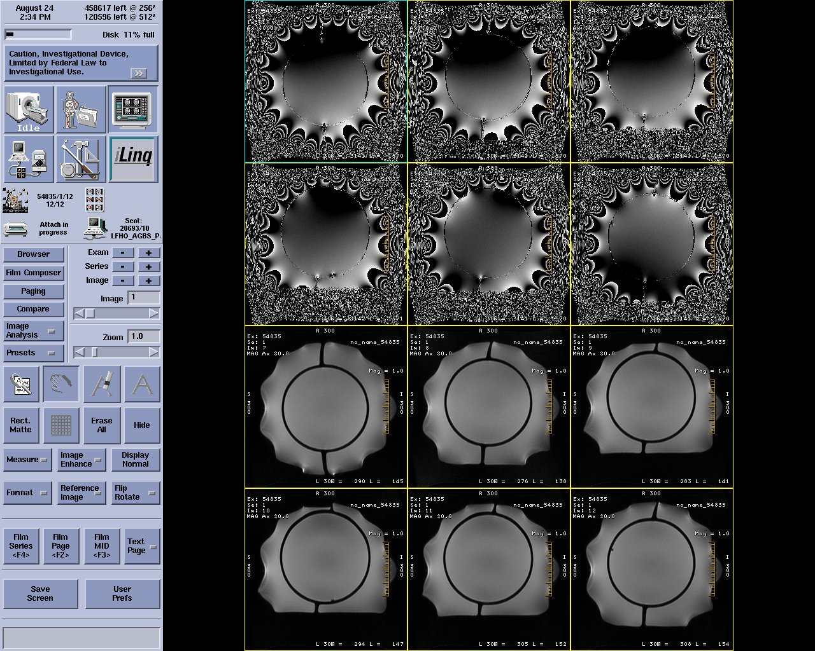
LV Shim Sample Images

Slide 13
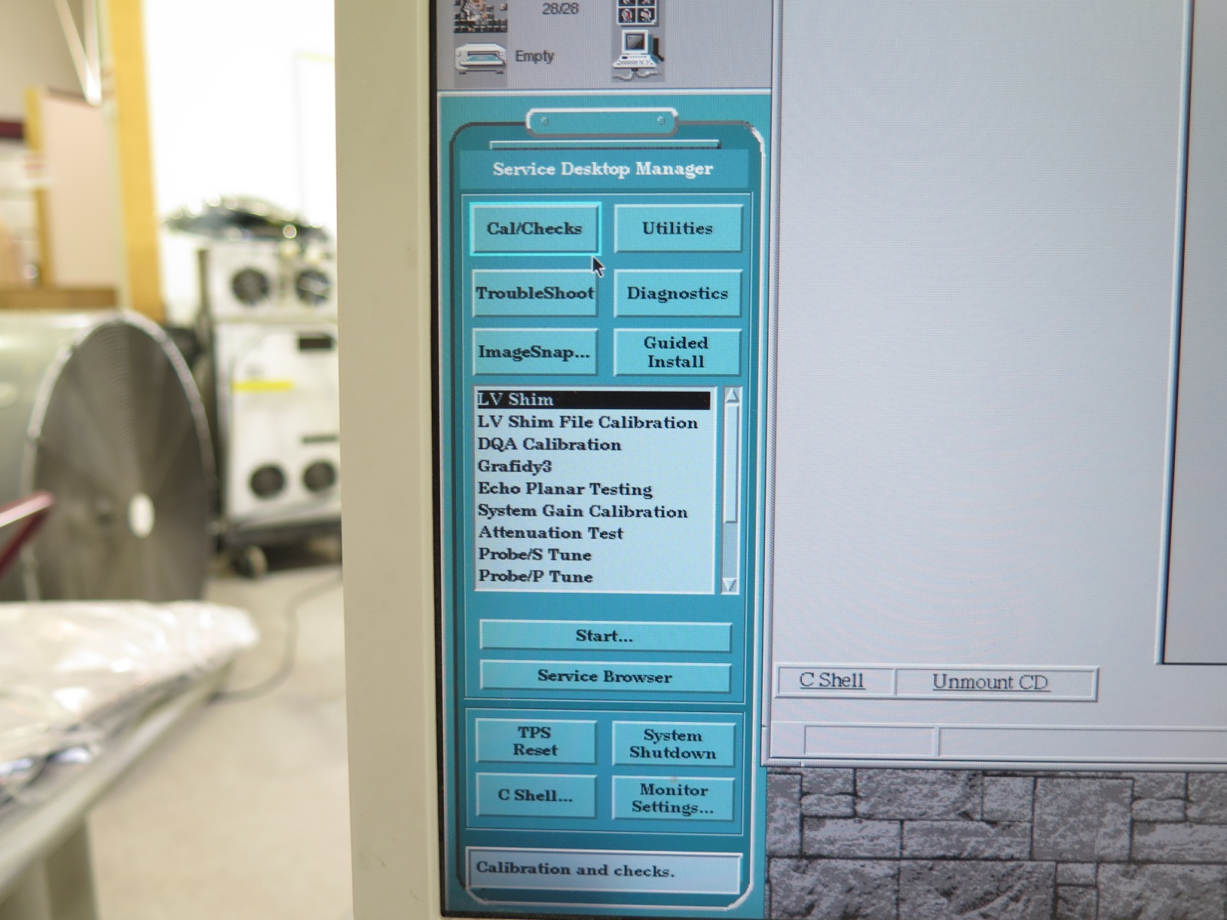
LV Shim Analysis
On the Tools Desktop,
select “Cal/Checks”
then “LV Shim” to
start the tool

Slide 14
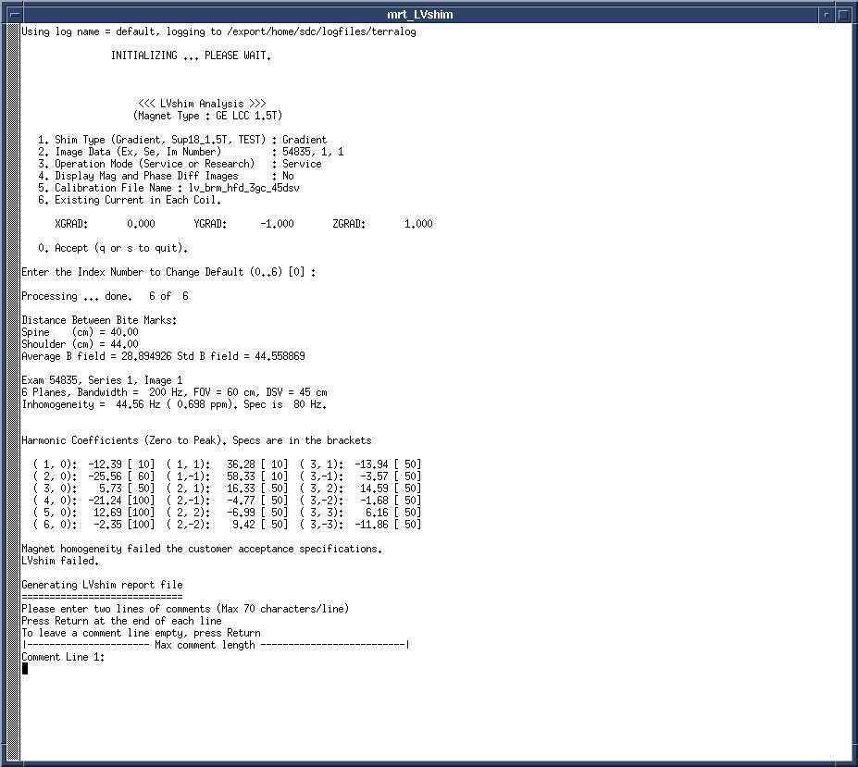
LV Shim Analysis Page 2
#1 selection is the Shim Type:
If you opened the tool after completing the first scan, all settings should be correct here and, after confirming all values, you can just hit the enter key.
If you need to change it. Pressing the corresponding number toggles through the setting.
i.e.: Toggle through “Shim Type” by
typing in “1” and hitting
enter repeatedly until Gradient is the one selected.

Slide 15
LV Shim Analysis Page 3
#5 selection is the calibration
file:
On 9.x, change it to 22 dsv
On 11.x and above change
it to 45dsv, most likely the
Default
Enter “0” to accept the settings
It will analyze the images and
give you a read out. You are
looking for the Inhomogeneity
number.
Spec:
9.X = less than 6hz
11.X and above = less than 80hz
Hit Enter twice

Slide 16
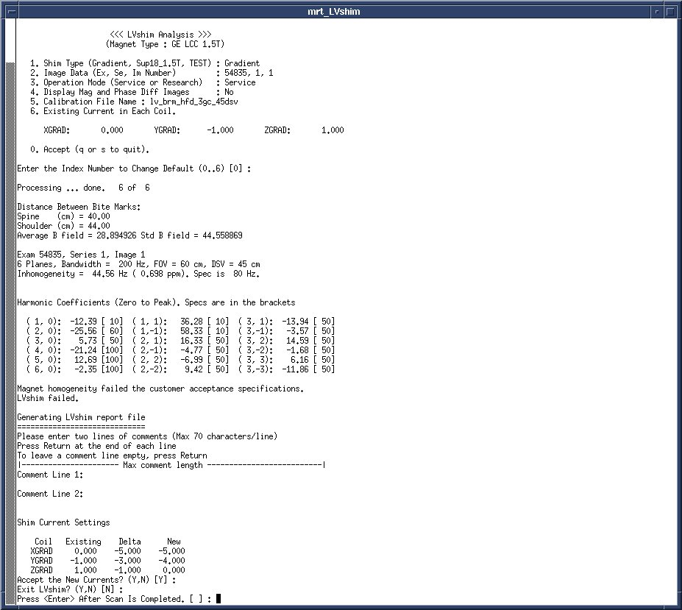
LV Shim Analysis Page 4
At the bottom you will see
“Shim Current Settings”, if the
numbers look reasonable accept
the new currents.
If you have deltas higher than 1 or
-1 then do not exit and proceed to
hit the scan button on the scan
page to start another series
of images. When the scan is
done, come back to this screen
and hit enter. It will take you back
to the beginning of the shim
analysis program. Continue until
the Inhomogeneity is in spec, if
that never happens, call support.

Slide 17
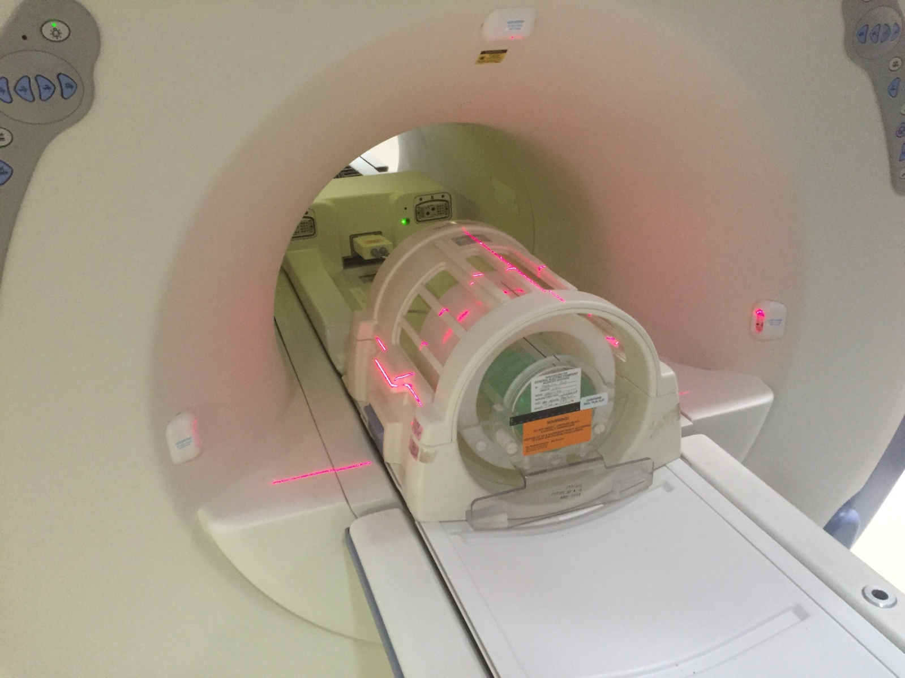
DQA Z ISO Procedure
Set up the Head Coil
and DQA III Phantom
like this and landmark
on the center, advance
to scan

Slide 18
DQA Z ISO Protocol
Isoz cal
Series Description - dqa isoz cal (must be named this)
Patient Position – Supine
Patient Entry - Head First
Coil - Head
Plane - Axial
Mode - 2D
Pulse Seq - Spin Echo
# of Echoes 1 (default)
TE [25]
TR [300]
Bandwidth [15.63] (default)
FOV [24]
Slice Thickness [3.0]
Spacing [1.5]
S/I Start 0
S/I End 0
# of Slices 1 (default)
Freq [512]
Phase [256]
NEX [1] (1:20)
Phase FOV 1.00 (default)
Freq Dir [A/P]
Auto Center Freq [Peak]

Slide 19
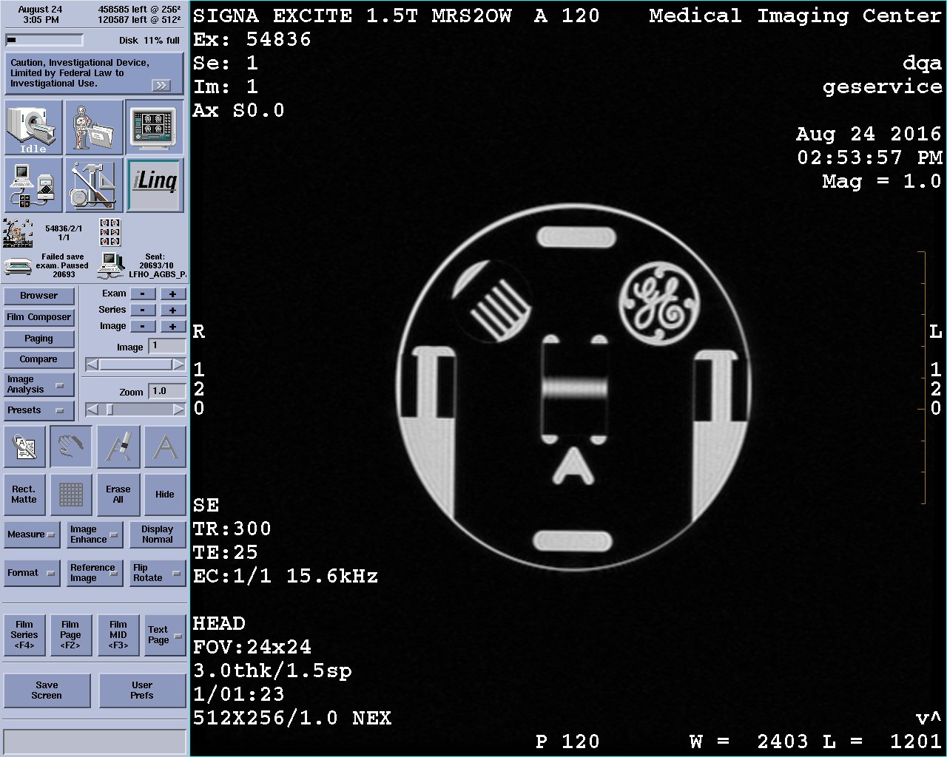
DQA Z ISO
Your image should look
like this. Also, record the
TG value.

Slide 20
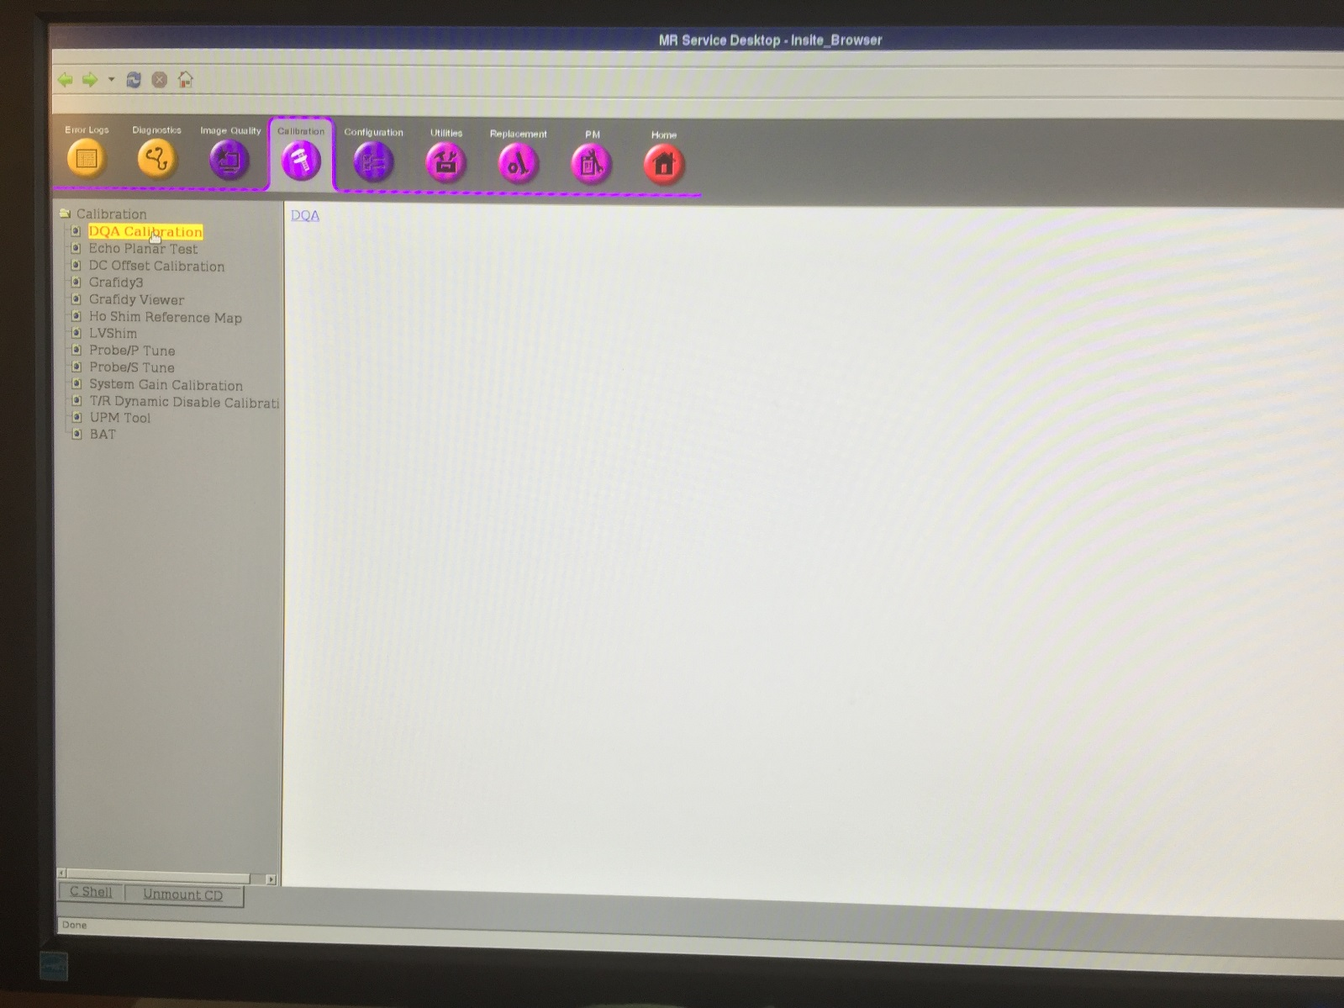
QA Z ISO Page 2
On the Service Desktop,
select “Calibration”
then “DQA Calibration”
Then “click here to start this tool” or “DQA”

Slide 21
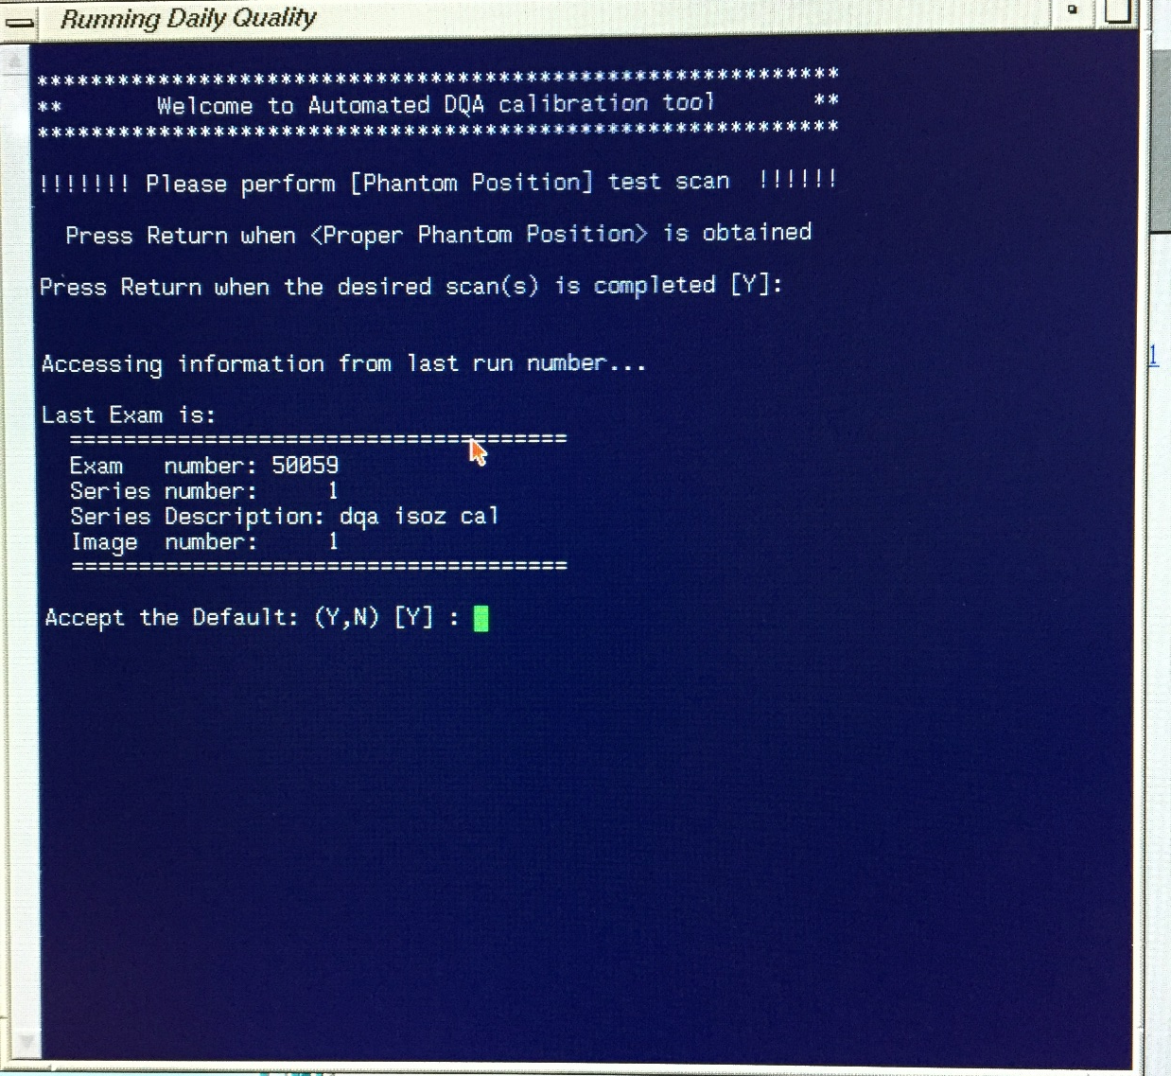
DQA Z ISO Page 3
In the window, hit enter to select thecurrent exam, series,
and image. If the
information is wrong,
choose the correct
one.

Slide 22
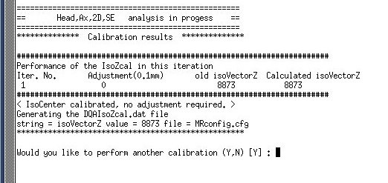
DQA Z ISO Page 3
If the Isocenter calibration is good then you will see this above.
If it is not, it will ask you if you want to update the Mrconfig.cfg. You can say yes but the new
calibration will not take effect until you do a TPS reset. It is recommended that if the value is
changed that you do a TPS reset and scan the ISO scan again to see if it analyzed and
updated it correctly.

Slide 23
Gradient Calibration (Grad Cal)
X, Y and Z Grad Cal are all done with the same procedure just different protocols. They also use the same analysis program that Z ISO used and same phantom in the same position.

Slide 24
Grad Cal Protocols
Please note the minute differences between the protocols
X Grad Cal
Series Description - dqa xfield cal (must be named this)
Patient Position – Supine
Patient Entry - Head First
Coil - Head
Plane - Coronal
Mode - 2D
Pulse Seq - Spin Echo
# of Echoes 1 (default)
TE [25]
TR [300]
Bandwidth [15.63] (default)
FOV [24]
Slice Thickness [3.0]
Spacing [1.5]
S/I Start 0
S/I End 0
# of Slices 1 (default)
Freq [512]
Phase [256]
NEX [1] (1:20)
Phase FOV 1.00 (default)
Freq Dir [R/L]
Auto Center Freq [Peak]
Y Grad Cal
Series Description - dqa yfield cal (must be named this)
Patient Position – Supine
Patient Entry - Head First
Coil - Head
Plane - Axial
Mode - 2D
Pulse Seq - Spin Echo
# of Echoes 1 (default)
TE [25]
TR [300]
Bandwidth [15.63] (default)
FOV [24]
Slice Thickness [3.0]
Spacing [1.5]
S/I Start 0
S/I End 0
# of Slices 1 (default)
Freq [512]
Phase [256]
NEX [1] (1:20)
Phase FOV 1.00 (default)
Freq Dir [A/P]
Auto Center Freq [Peak]
Z Grad Cal
Series Description - dqa zfield cal (must be named this)
Patient Position – Supine
Patient Entry - Head First
Coil - Head
Plane - Coronal
Mode - 2D
Pulse Seq - Spin Echo
# of Echoes 1 (default)
TE [25]
TR [300]
Bandwidth [15.63] (default)
FOV [24]
Slice Thickness [3.0]
Spacing [1.5]
S/I Start 0
S/I End 0
# of Slices 1 (default)
Freq [512]
Phase [256]
NEX [1] (1:20)
Phase FOV 1.00 (default)
Freq Dir [S/I]
Auto Center Freq [Peak]

Slide 25
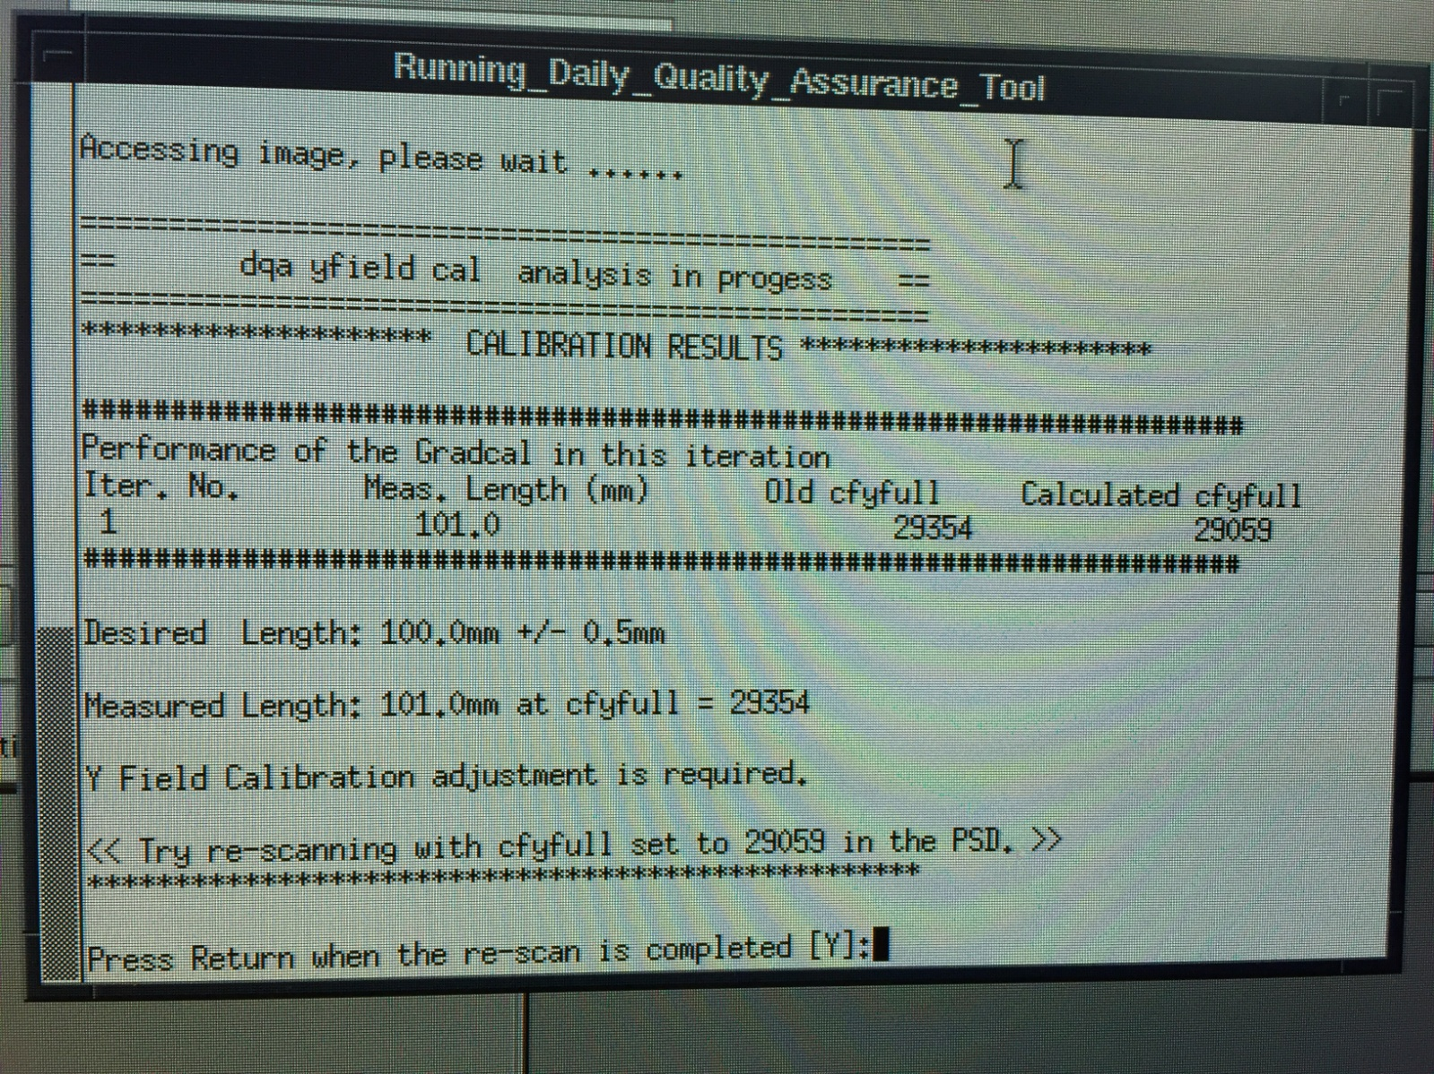
Grad Cal Procedure
There are 2 possible
out comes to the
analysis of the images.
It says “No
Adjustment Required”
In which case you are
done with the
calibration on that axis
2. You will get a screen
like you see here.
In that case we need to
modify a CV on the
scan page and rescan

Slide 26
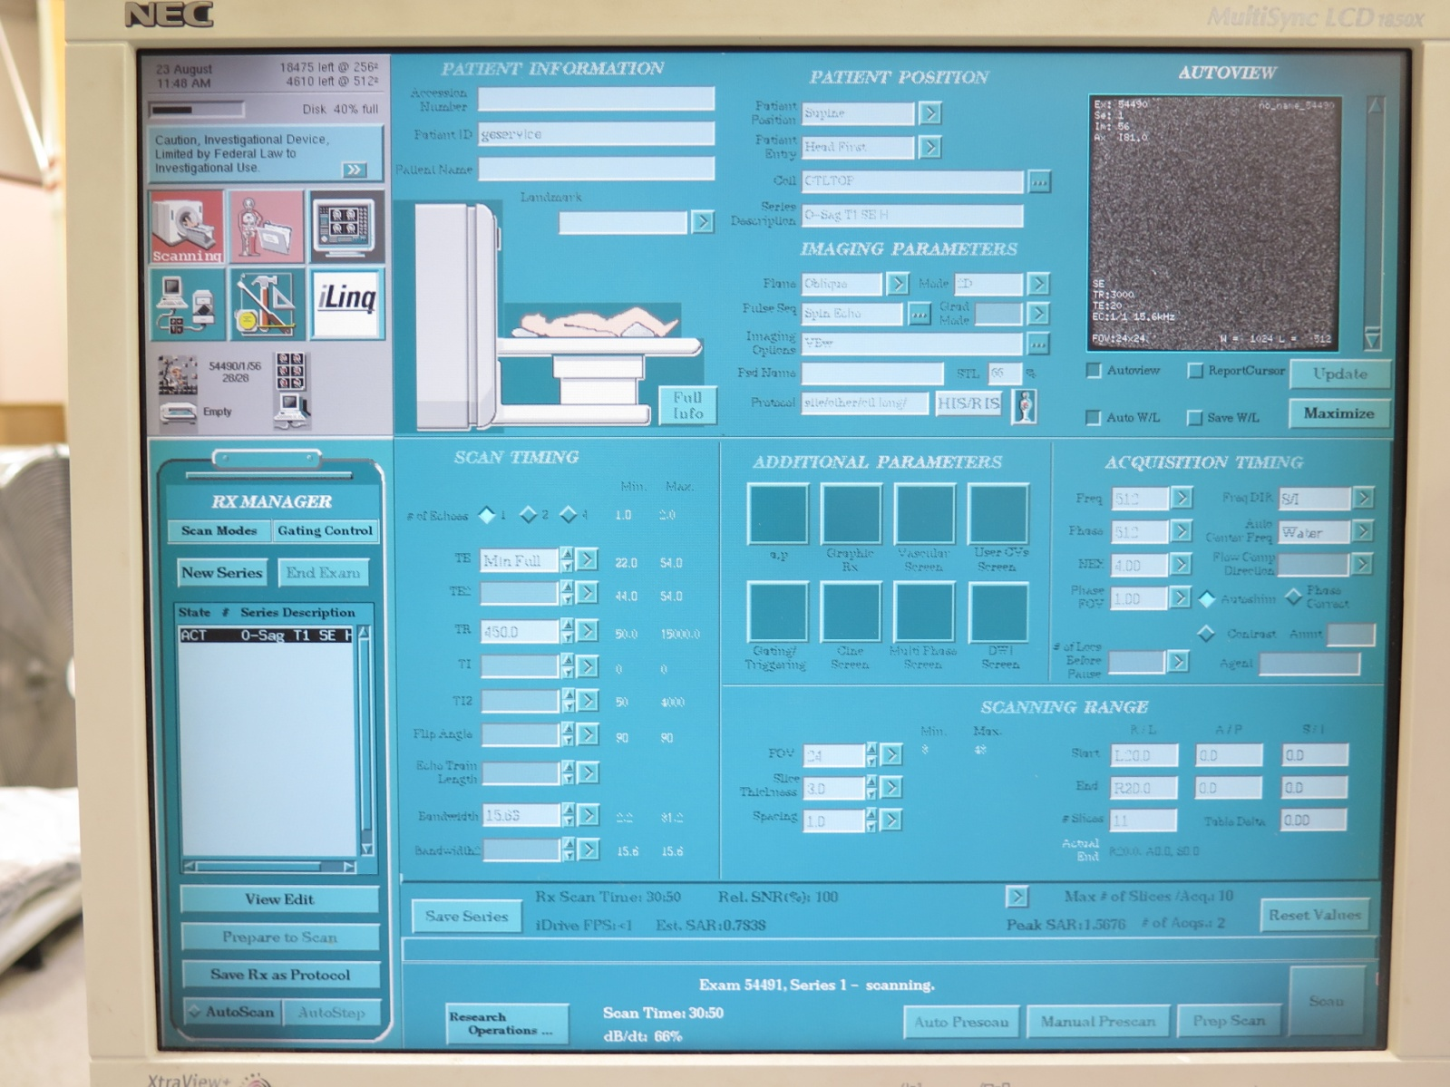
Grad Cal Procedure Page 2
Left click on Research
Operations and choose
Modify CV’s. In the
window that comes up
you have to type in the
proper CV name
depending on the cal
you’re doing.
X= cfxfull
Y= cfyfull
Z= cfzfull
And then enter the new
value given in the
analysis and rescan and
then go back to the
analysis program and
hit enter to analyze the
new image. Continue
until it says “No
Adjustment Required”

Slide 27
Head and Body SNR
Head and Body SNR scans are very similar. They use very similar Protocols and Phantoms.
The SNR numbers obtained are subjective and are specific to your machine. We can use numbers from other scanners to get a range that your machine should be within. The SNR number are mainly used to detect a trending issue but can be use for troubleshooting.

Slide 28
Head and Body SNR Protocol
Head SNR
Series Description – Head SNR
Patient Position – Supine
Patient Entry - Head First
Coil - Head
Plane - Axial
Mode - 2D
Pulse Seq - Spin Echo
# of Echoes 1 (default)
TE [20]
TR [500]
FOV [24]
Slice Thickness [3]
Spacing [1.5]
Start 0
End 0
# of Slices 1 (default)
L/R Center 0 (default)
P/A Center 0 (default)
Freq [256]
Phase [256]
NEX [1]
Phase FOV 1.00 (default)
Freq Dir [A/P]
Auto Center Freq [Peak]
Body SNR
Series Description - Body SNR
Patient Position – Supine
Patient Entry - Head First
Coil - Body
Plane - Axial
Mode - 2D
Pulse Seq - Spin Echo
# of Echoes 1 (default)
TE [20]
TR [500]
FOV [48]
Slice Thickness [3]
Spacing [1.5]
Start 0
End 0
# of Slices 1 (default)
L/R Center 0 (default)
P/A Center 0 (default)
Freq [256]
Phase [256]
NEX [1]
Phase FOV 1.00 (default)
Freq Dir [A/P]
Auto Center Freq [Peak]

Slide 29

Head SNR Procedure
Put the Head TLT phantom
in to the head coil at the
same spot that the DQA
phantom was.
Scan. When the scan is done,
hit the Scan button again, do
not autoprescan or start a
new series. You should have
2 images that look identical.
Need pic of Head TLT in the head coil

Slide 30
Head SNR Analysis
On the Tools Desktop,
select “Cal/Checks”
then “Image Quality
(NEMA)” to start the
tool.

Slide 31
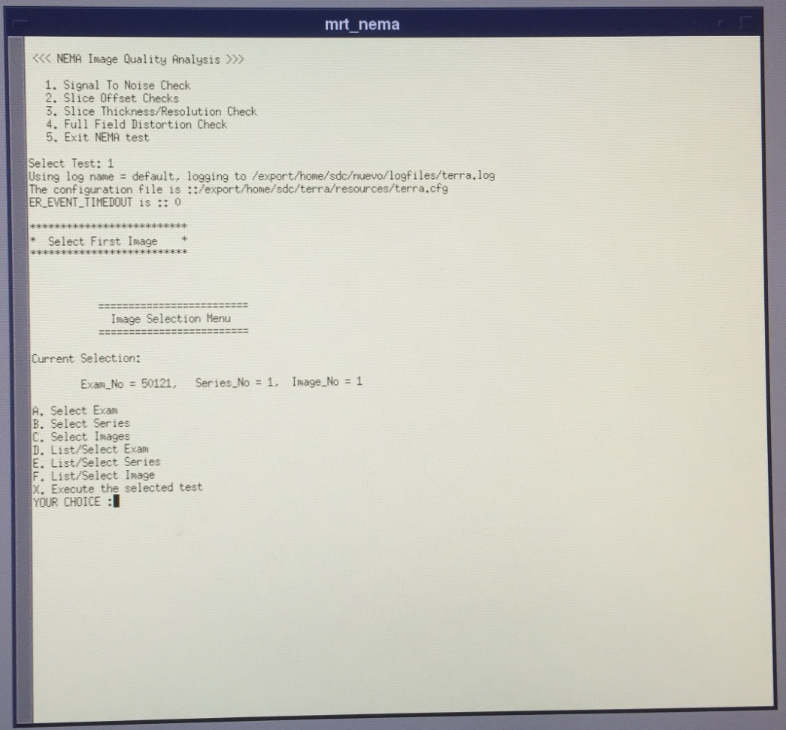
Head SNR Analysis Page 2
Select option 1.
You will need to select the right information for image 1 and then select X for execute. Then select the right information for image 2 and X for execute. It might ask you another question, use the default
value.

Slide 32
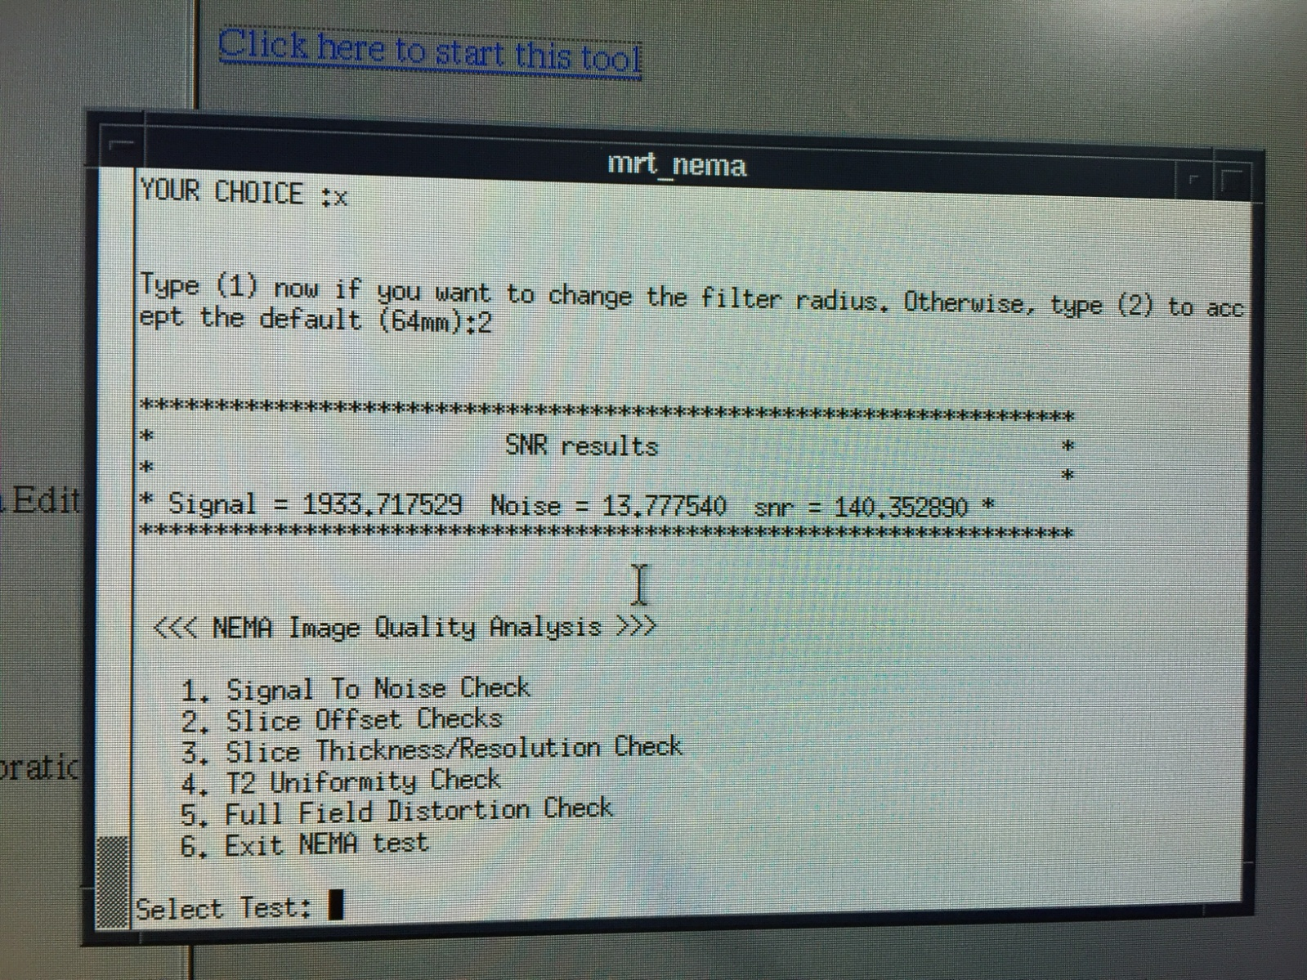
Head SNR Analysis Page 2
Record all 3 values.
9.X is typically 80 to 100
11.X and above is
typically higher than 100

Slide 33
Body SNR
Body SNR is performed
the same way as the Head
but with the Body
Phantom. Scan and
analyze with the head
instructions.
Pic of the Body TLT setup

Slide 34
Safety and Regulatory Checks
Not Applicable
Under System Level Procedures
Squeeze the Patient alert bulb
TG Values written down
Under Patient Table
Under Patient Table
Under Patient Table
Under Patient Table
Under Patient Table
Under Patient Table
Under Patient Table
Under System Level Procedures
Under RF Cabinet, Select yours
See GE MRI Signa LX training PPT
Check O2 Monitor Operation (if applicable)
Check Peripheral Pulse Gating Cable
Check Patient Pneumatic Alert System
Check RF Power Output
Check Emergency Release of Cradle
Check Emergency Release of Patient Transport
Check Patient Transport Casters
Check Patient Armboard Setscrews
Verify That Cradle Must Be At Home To Lower Table
Check Cradle Longitudinal Drive Clutch
Check All Cradle and Carriage Wheels
Check Emergency Off Circuits
Check Power Monitor Functional Test
Check Magnet Run Down Unit (ERU, MRU)

Slide 35
Other Checks
Under Blowers and Chillers
Under Patient Table
Under Patient Table
Under Magnet Enclosures
Check Gradient Coil Cooling Unit
Check Dock Pedal Springs
Check Patient Transport Hydraulic Fluid Level
Check Patient Alignment Lights

Slide 36
Delete Error Log and Remove Excess "core" Files
Delete the Error Log:
In a c-shell type storelog
Remove core files:
In a c-shell type cd /usr/g/service/log <enter>
Type rm –rf *core*

Slide 37
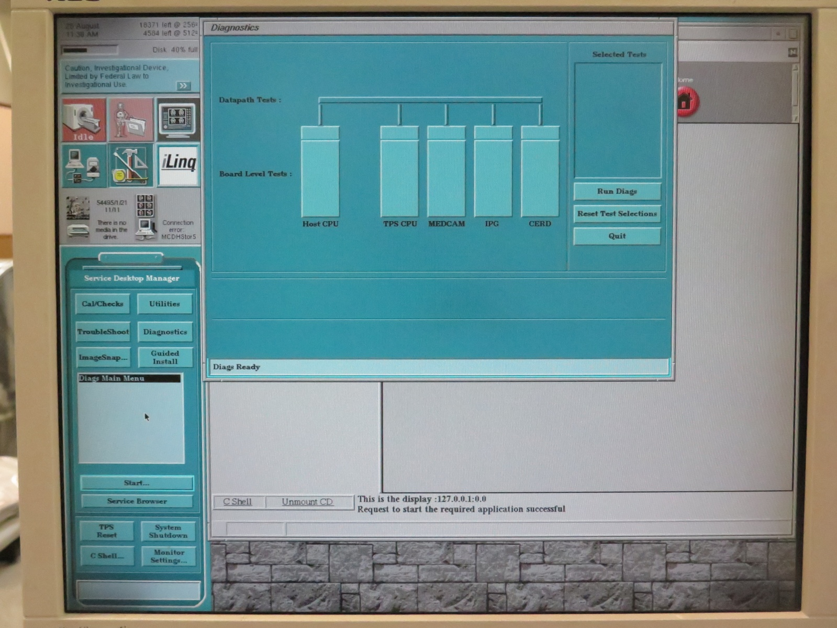
Run IPG, CERD and MECAM Diagnostics
Select the Tools page
Select “Diagnostics”
Run all diagnostic tests
under CERD
Run all “MDS” and
“BLD” under IPG
Run all under
“MEDCAM”

Slide 38
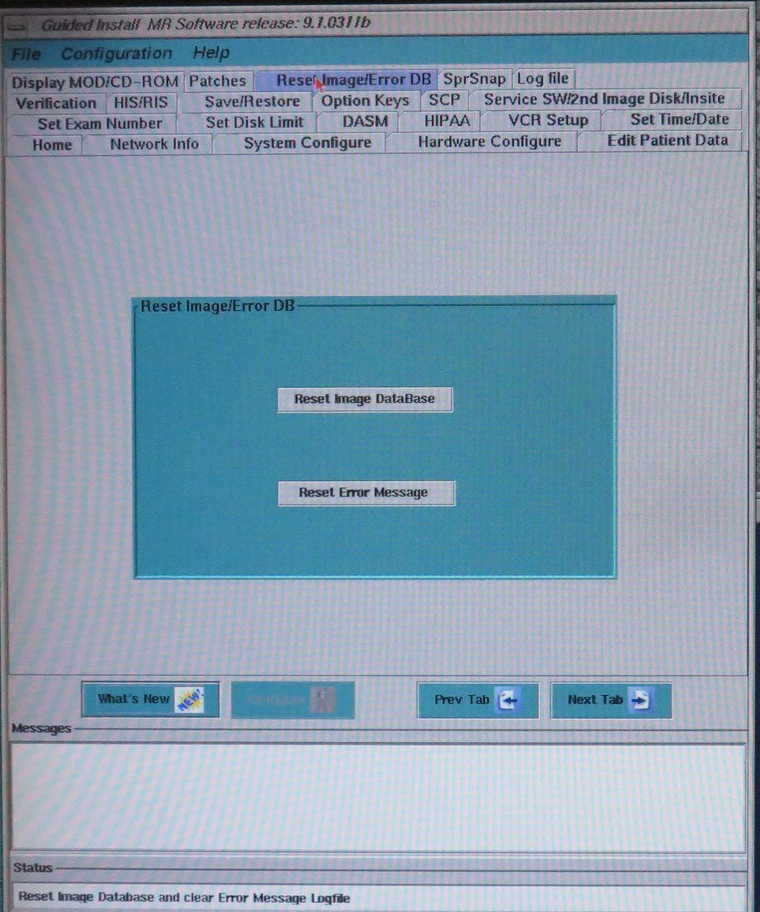
Image Database
If you are having patient browser issues or regularly on 9x.
Delete all browser patient images (make sure to communicate with your customer you are going to delete all the studies, no way to recover them after)
Restart system and log in as “root”, password “operator” and prompt.
When asked if you want to invoke the Guided Install say yes.
Navigate to the Reset Image/Error DB tab and hit “Reset Image Database”.
If the browser was empty should just take a few minutes. If you forget to empty the browser you’ll wait for hours.

Slide 39
Magnet Checks
All values get recorded
Check the gauge on the magnet and the Magnet Monitor
On the front of the Shield Cooler
See below
On the Magnet Monitor
Gauge on the Shield Cooler
Record Magnet Pressure
Record Shield Cooler Hours
Calculate Lost Hours of Shield Cooler
Record Helium Level
Record Static Shield Cooler Compressor Pressure
Calculate Lost Hours
Take the hours you recorded on the last PM and subtract them from the hours on this PM. That will give you a total minutes lost. Divide by 60 to get the total hours. If there has been a helium loss since the last PM, this could account for it.

